Slide 1
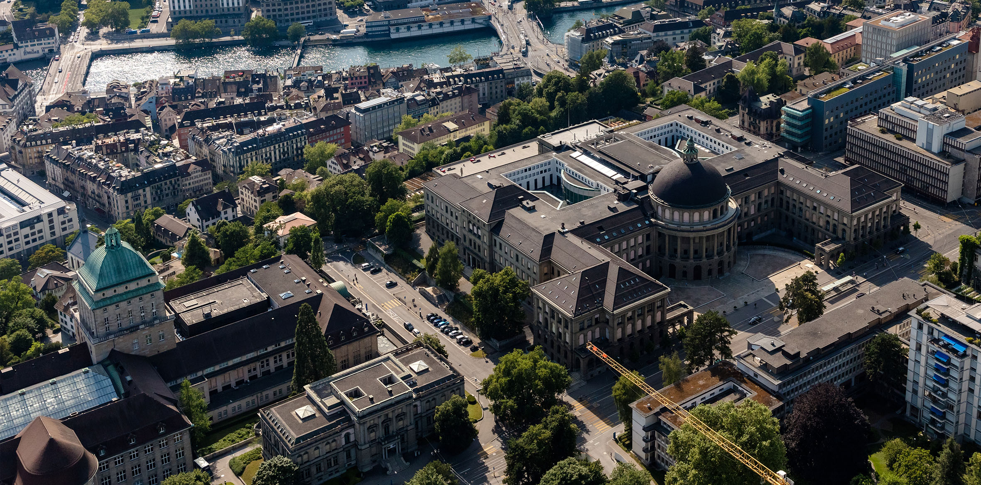

Economics and Policy of Pesticide-Free Agricultural Production
‘European Scientific Conference – Towards Pesticide Free Agriculture’, Dijon June 2-3, 2022
Robert Finger (ETH Zürich, Switzerland) with Niklas Möhring & Viviana Garcia
Notes:
Pesticides and EU and Swiss pesticide polices
Case Study: Pesticide-free wheat production
Lessons learned: How to enable pesticide-free production?

Slide 2
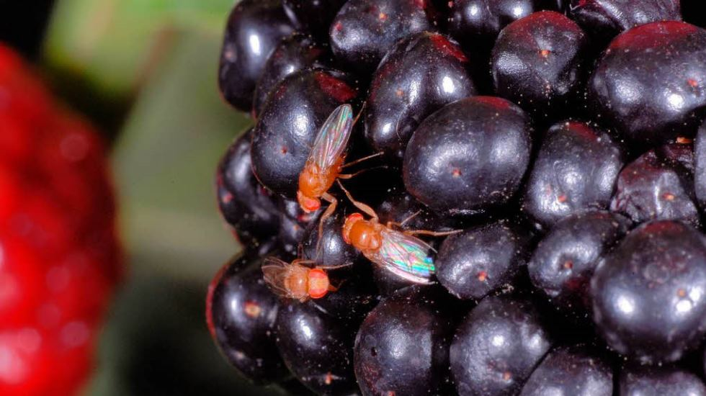
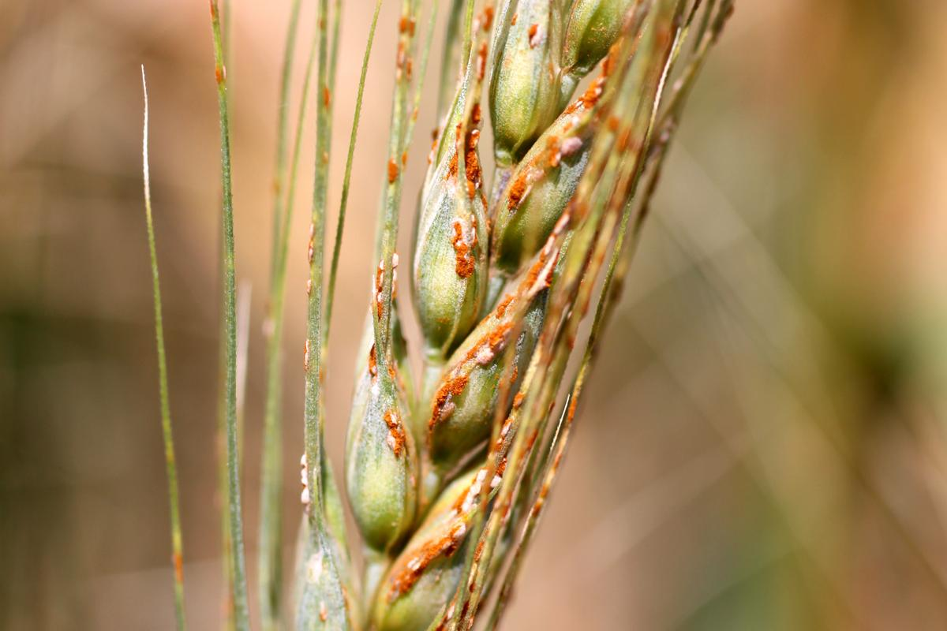
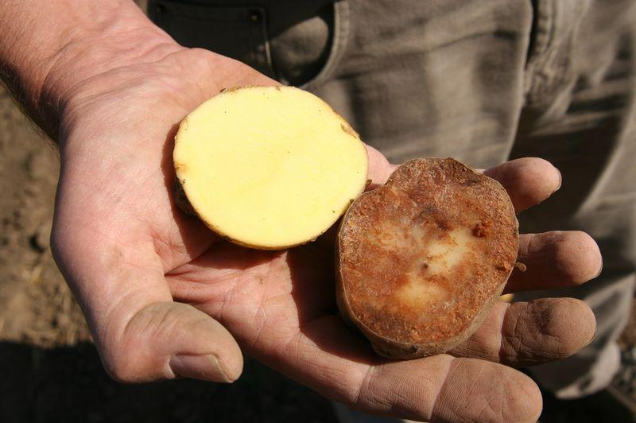

Plant protection is crucial
Pest management is crucial for food security and ecosystem service provision of agricultural sector
Large losses in crop quantity and quality without pest management (e.g. Oerke 2006, Savary et al. 2019, Deutsch et al. 2018)
Deutsch, C. A., Tewksbury, J. J., Tigchelaar, M., Battisti, D. S., Merrill, S. C., Huey, R. B., & Naylor, R. L. (2018). Increase in crop losses to insect pests in a warming climate. Science, 361(6405), 916-919.
Oerke, E. C. (2006). Crop losses to pests. The Journal of Agricultural Science, 144(1), 31-43.
Savary, S., Willocquet, L., Pethybridge, S. J., Esker, P., McRoberts, N., & Nelson, A. (2019). The global burden of pathogens and pests on major food crops. Nature ecology & evolution, 3(3), 430.
Notes:
2

Slide 3
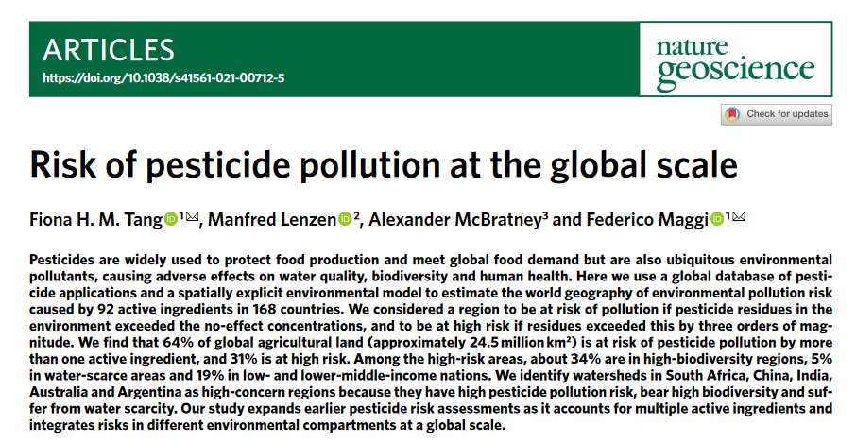
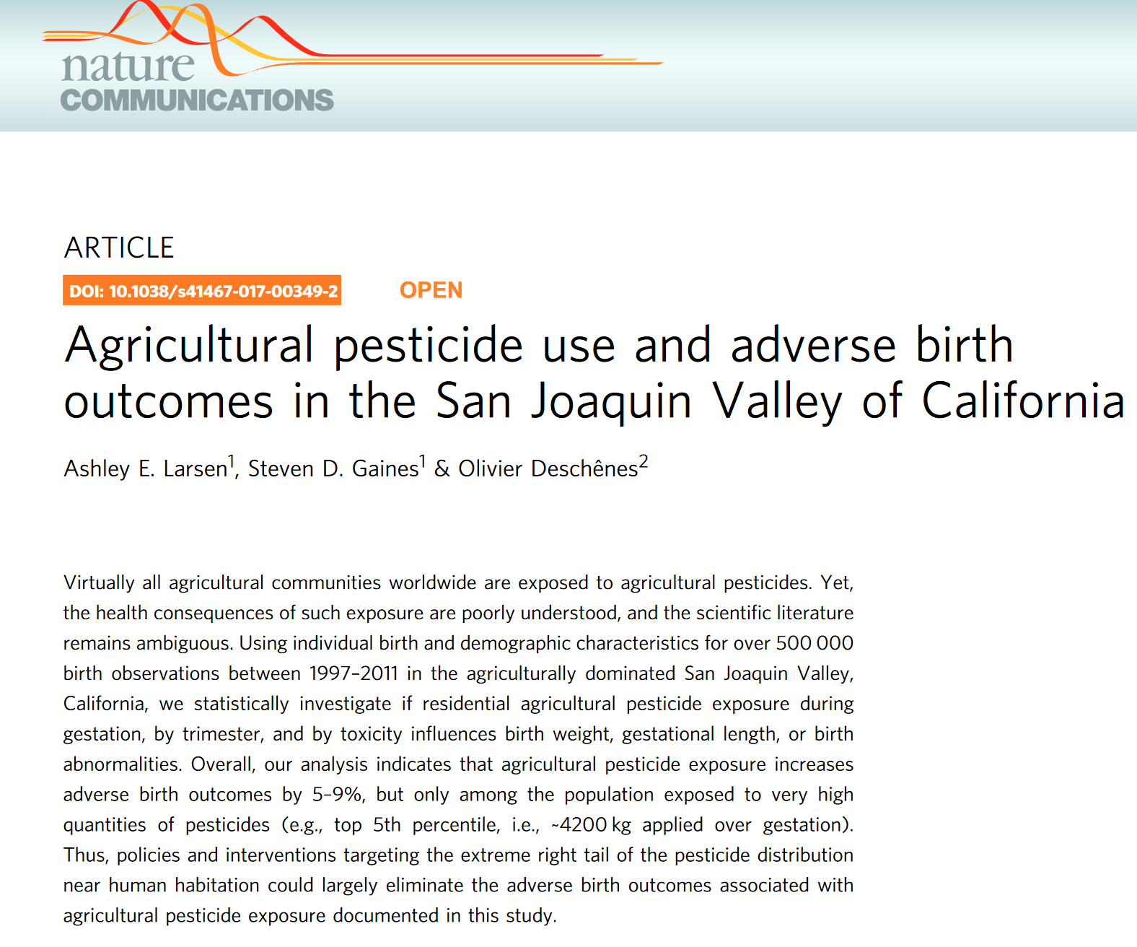
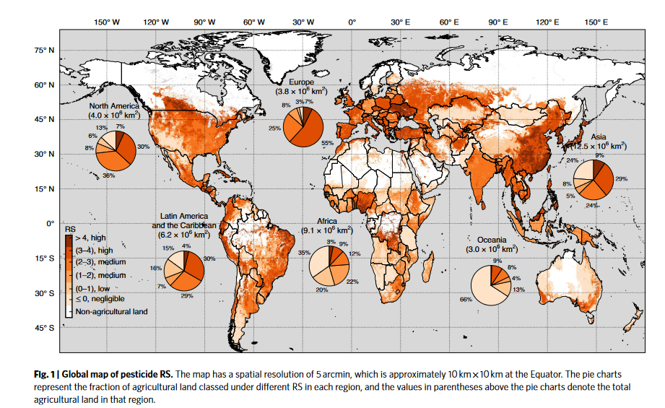

Pesticide use has negative impacts on the environment and human health
Larsen, A. E., Gaines, S. D. & Deschênes, O. Agricultural pesticide use and adverse birth outcomes in the San Joaquin Valley of California. Nat. Commun. 8, 302 (2017).
Mesnage , Finger, R et al. . (2021). Improving pesticide-use data for the EU. Nature Ecology & Evolution
Stehle, S. & Schulz, R. Agricultural insecticides threaten surface waters at the global scale. Proc. Natl Acad. Sci. USA 112, 5750–5755 (2015).
European Court of Auditors (2020) Special Report 05/2020: Sustainable Use of Plant Protection Products: Limited Progress in Measuring and Reducing Risks
Tang, F. H., Lenzen, M., McBratney, A., & Maggi, F. (2021). Risk of pesticide pollution at the global scale. Nature Geoscience, 14(4), 206-210.

Slide 4
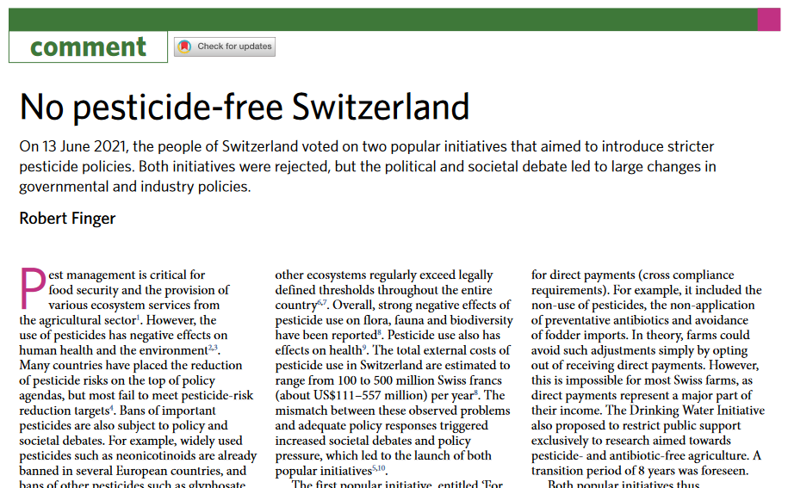
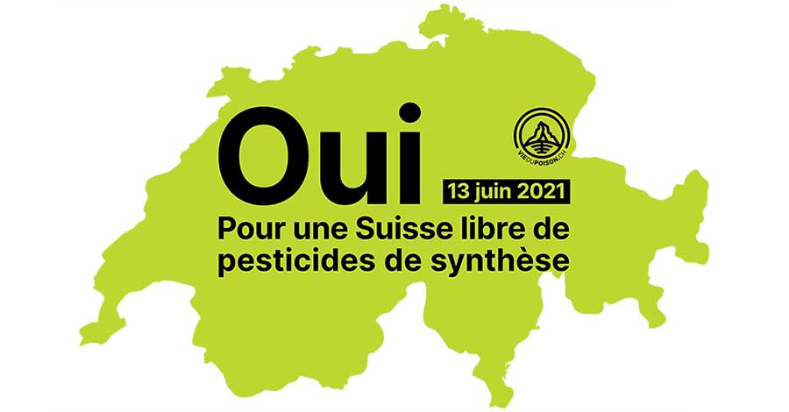
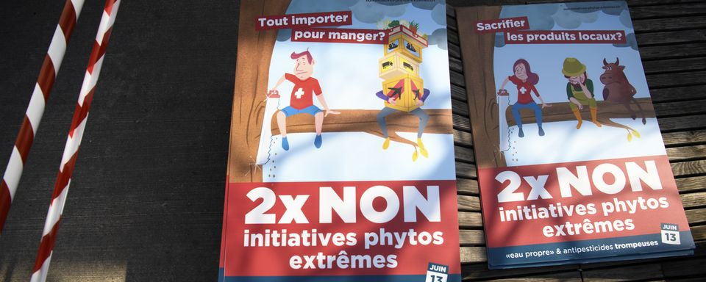
(No) pesticide-free Switzerland
Both initiatives rejected in June 2021, ca. 40% voted for initiatives.
But: large adjustment processes in agriculture, policy, industry as compromise

Slide 5
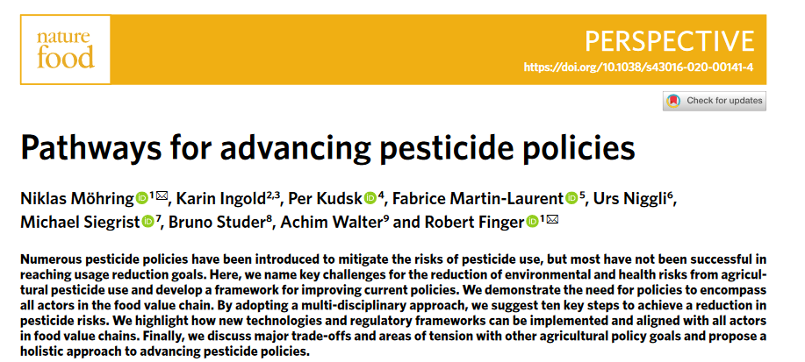
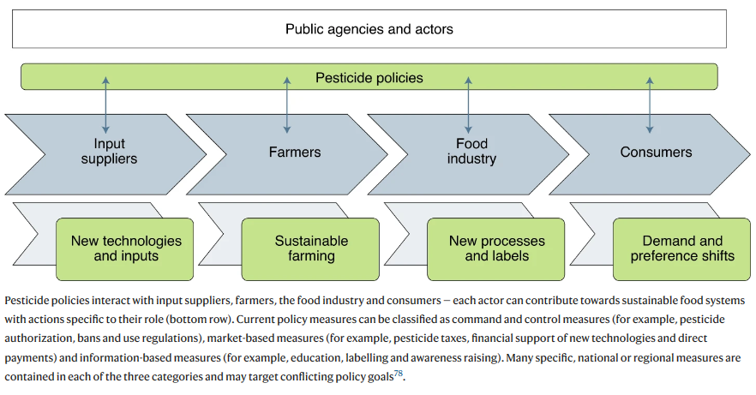
Involvement of all actors required
Möhring, N., Ingold, K., Kudsk, P., Martin-Laurent, F., Niggli, U., Siegrist, M., Studer, B., Walter, A., Finger, R. (2020). Pathways for advancing pesticide policies. Nature Food 1, 535–540.

Slide 6
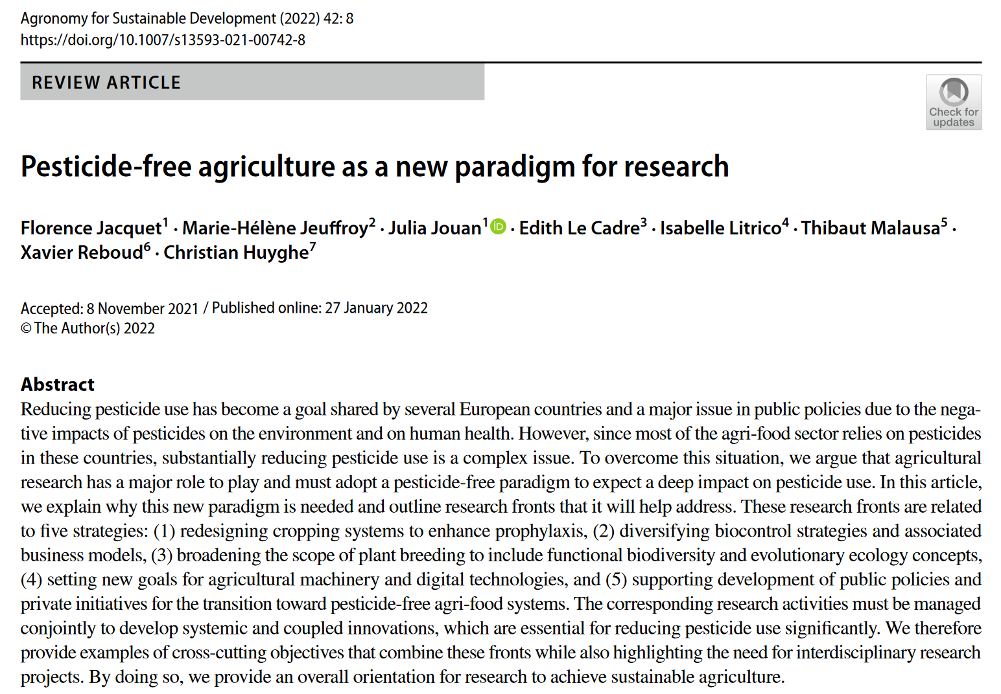
Jacquet, F., Jeuffroy, M. H., Jouan, J., Le Cadre, E., Litrico, I., Malausa, T., ... & Huyghe, C. (2022). Pesticide-free agriculture as a new paradigm for research. Agronomy for Sustainable Development, 42(1), 1-24.

Slide 7
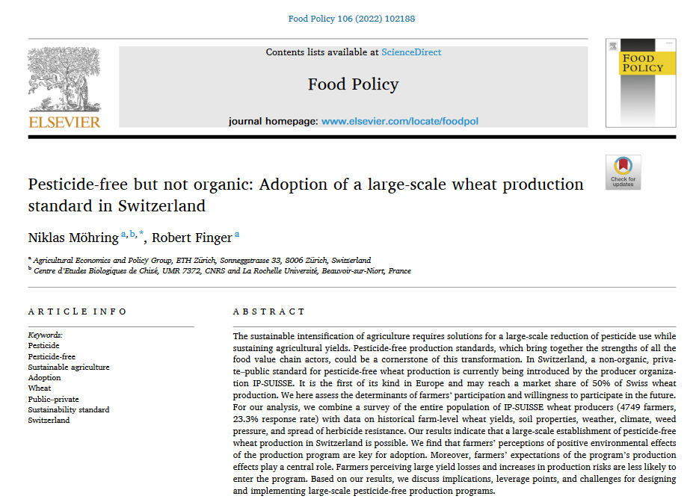
Böcker, T., Möhring, N., Finger, R. (2019). Herbicide free agriculture? A bio-economic modelling application to Swiss wheat production. Agricultural Systems 173, 378-392
Möhring, N., Finger, R. Pesticide-free but not organic? Adoption of a large-scale pesticide-free wheat production standard in Switzerland. Food Policy 106: 102188
Finger, R., & Möhring, N. (2022). The adoption of pesticide-free wheat production and farmers' perceptions of its environmental and health effects. Ecological Economics, 198, 107463.

Slide 8
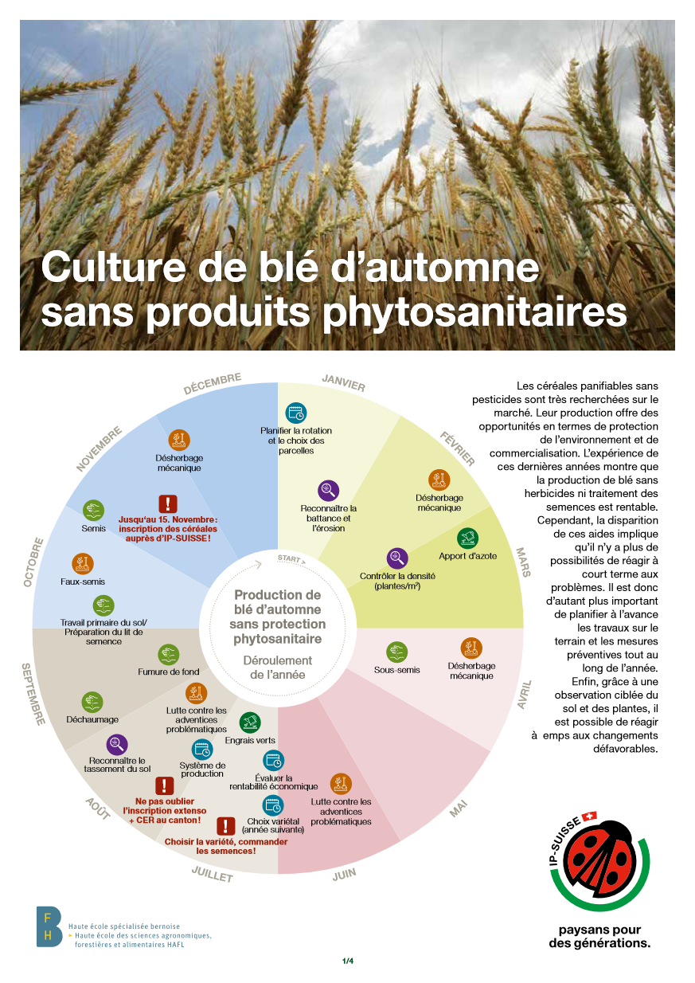
Pesticide-free wheat production achieved using a combination of different pest prevention and non-chemical pest control measures, for example:
Crop rotations are adjusted (e.g., wide rotations are used and no wheat after wheat)
Varieties with high resistance to fungi infestation are selected
Mechanical weed control replaces the use of herbicides
Not organic: artificial fertilizer & no implications for pesticide use in the rest of the crop rotation
Böcker, T., Möhring, N., Finger, R. (2019). Herbicide free agriculture? A bio-economic modelling application to Swiss wheat production. Agricultural Systems 173, 378-392
Möhring, N., Finger, R. (2021) Pesticide-free but not organic? Adoption of a large-scale pesticide-free wheat production standard in Switzerland. Food Policy 106: 102188

Slide 9
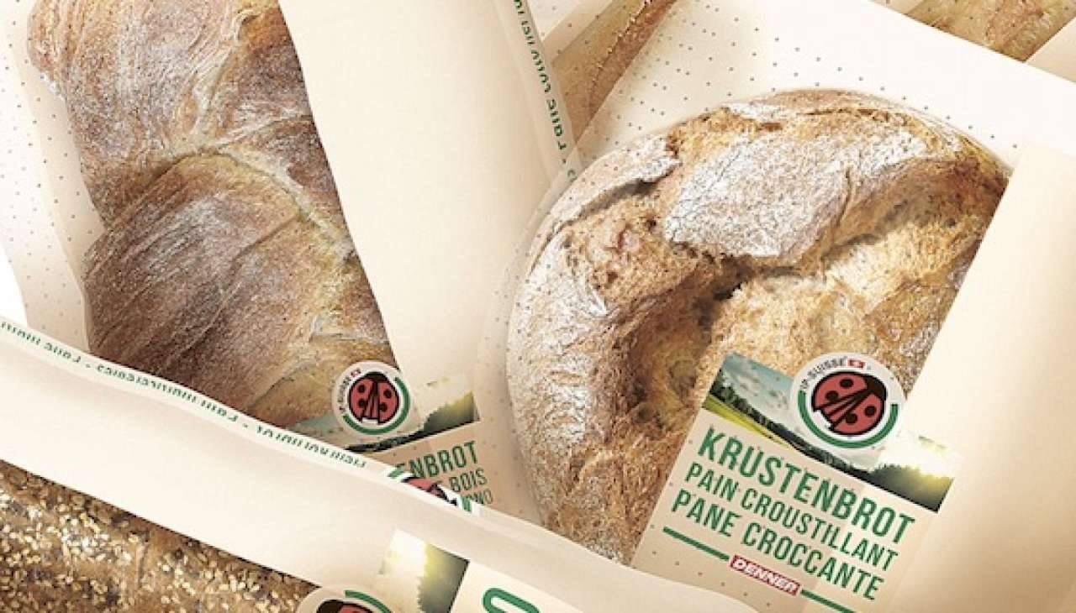
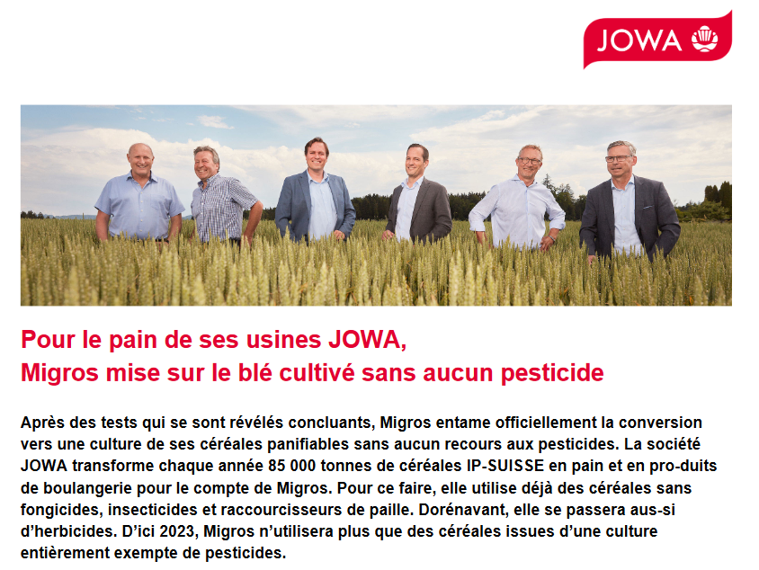
Yield losses (ca. 20% compared to conventional), additional costs & opportunity costs
Compensation via direct payments (+650 CHF/ha, +16% cp. to conventional) and price markups (+10CHF/dt, +20% cp. to conventional)
The largest retailer Migros and its bakery Jowa decided to sell only bread from pesticide-free (and organic) cereals (starting 2023)
Böcker, T., Möhring, N., Finger, R. (2019). Herbicide free agriculture? A bio-economic modelling application to Swiss wheat production. Agricultural Systems 173, 378-392
Möhring, N., Finger, R. (2021) Pesticide-free but not organic? Adoption of a large-scale pesticide-free wheat production standard in Switzerland. Food Policy 106: 102188

Slide 10
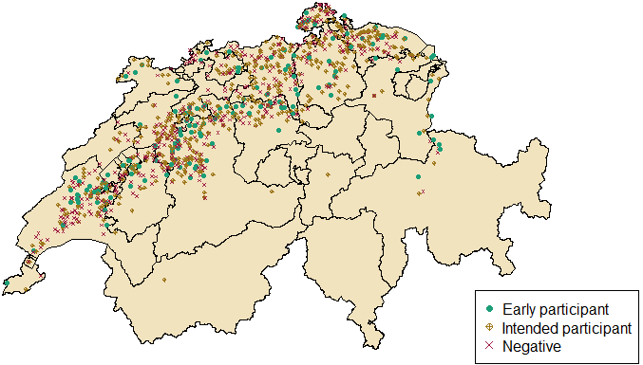
Survey 2019/20: Participation decision: spatial distribution (N=1105). 14% (early) adopters, and additional 44% intend to adopt

Slide 11
First insights in adoption determinants I/II
Structural characteristics of the farm (region, share of wheat, farm size) and farm manager (age, education, etc.) no determinants for program participation
Lower participation if high perceived yield, price, policy & investment risk of novel production system…and for higher risk aversion
Lower participation if expected yield loss higher
Economic incentives from public and private sector matter
  Marketing channel: IP Suisse price premium
  Federal direct payments
All differences are significant with only three exceptions: Direct payments, IP-SUISSE program and investment risk between early adopters and farmers that postpone (Garcia et al. 2022)
Möhring, N., Finger, R. Pesticide-free but not organic? Adoption of a large-scale pesticide-free wheat production standard in Switzerland. Food Policy 106: 102188
Garcia, V., Wang, Y., Möhring, N., Finger, R. Risk perceptions, preferences and the adoption dynamics of pesticide-free production. Submitted
Finger, R., & Möhring, N. (2022). The adoption of pesticide-free wheat production and farmers' perceptions of its environmental and health effects. Ecological Economics, 198, 107463.

Slide 12
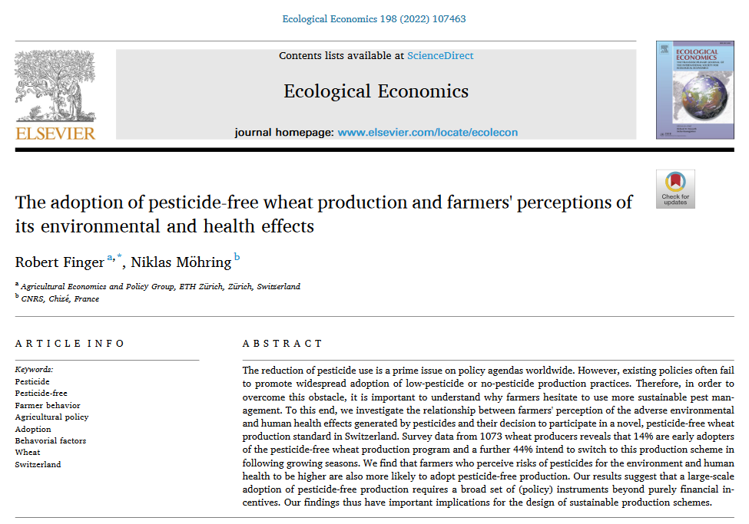
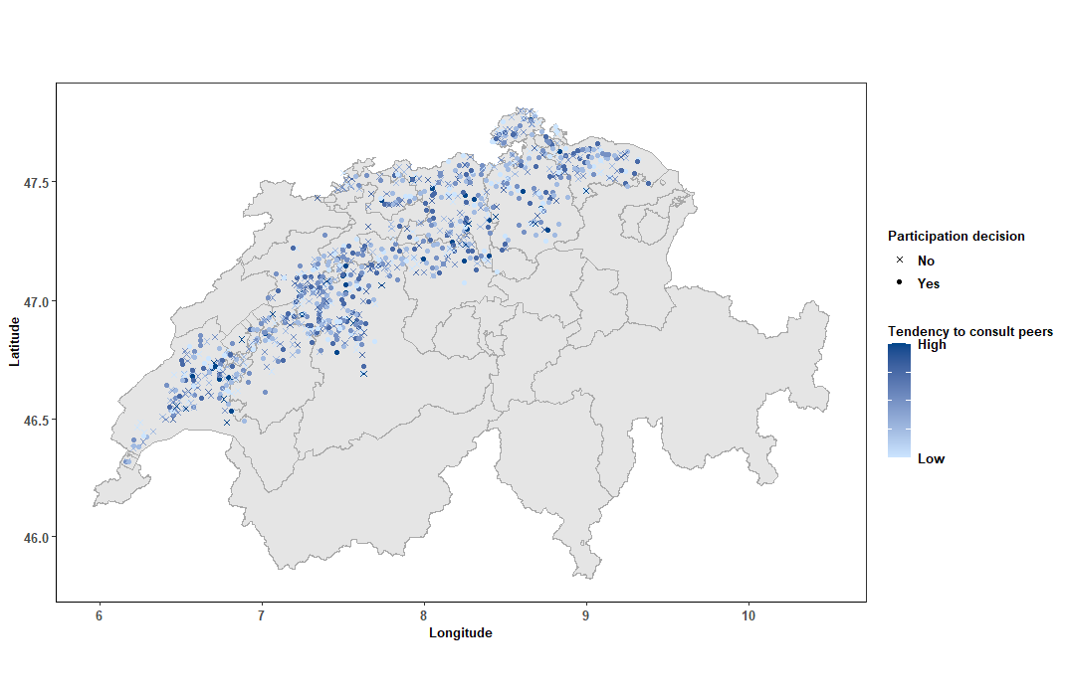
First insights in adoption determinants II/II
Positive perception environmental & health impact of program
Information/exchange colleagues
Path dependency and goal conflicts: conservation tillage programs, machinery availability
Wang et al. 2022
Möhring, N., Finger, R. Pesticide-free but not organic? Adoption of a large-scale pesticide-free wheat production standard in Switzerland. Food Policy 106: 102188
Garcia, V., Wang, Y., Möhring, N., Finger, R. Risk perceptions, preferences and the adoption dynamics of pesticide-free production. Submitted
Finger, R., & Möhring, N. (2022). The adoption of pesticide-free wheat production and farmers' perceptions of its environmental and health effects. Ecological Economics, 198, 107463.
Wang, Y., Möhring, N., Finger, R. (2022). When my neighbors matter: spillover effects in the adoption of large-scale pesticide-free wheat production. Submitted

Slide 13
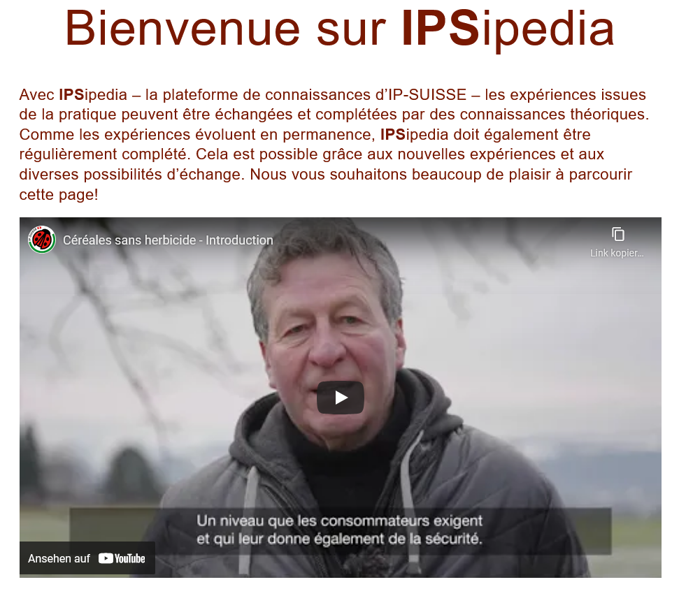
Lessons learned for pesticide-free production
Farmers need to be paid for adoption of pesticide-free practices
Reducing risks and aligning risk perceptions is key
Targeted information and extension needed
Möhring, N., Finger, R. Pesticide-free but not organic? Adoption of a large-scale pesticide-free wheat production standard in Switzerland. Food Policy 106: 102188
Finger, R., & Möhring, N. (2022). The adoption of pesticide-free wheat production and farmers' perceptions of its environmental and health effects. Ecological Economics, 198, 107463.
Mack, G., Finger, R, et al. (2022). Bio-economic modeling of national-scale transition into pesticide-free (but not organic) production systems. In Preparation

Slide 14
Lessons learned for pesticide-free production
Farmers need to be paid for adoption of pesticide-free practices
Reducing risks and aligning risk perceptions is key
Targeted information and extension needed
Go beyond monetary incentives. Disclosure of information (e.g. pesticide risk)
Exploit the power of networks
Key trade-offs (yields, conservation agriculture) remain, need targeted action
Assessment of sector-level implications of pesticide-free production needed (Mack et al. 2022)
Möhring, N., Finger, R. Pesticide-free but not organic? Adoption of a large-scale pesticide-free wheat production standard in Switzerland. Food Policy 106: 102188
Finger, R., & Möhring, N. (2022). The adoption of pesticide-free wheat production and farmers' perceptions of its environmental and health effects. Ecological Economics, 198, 107463.
Mack, G., Finger, R, et al. (2022). Bio-economic modeling of national-scale transition into pesticide-free (but not organic) production systems. In Preparation

Slide 15
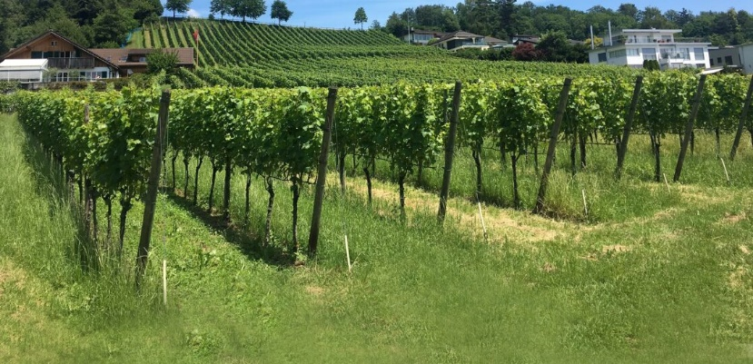
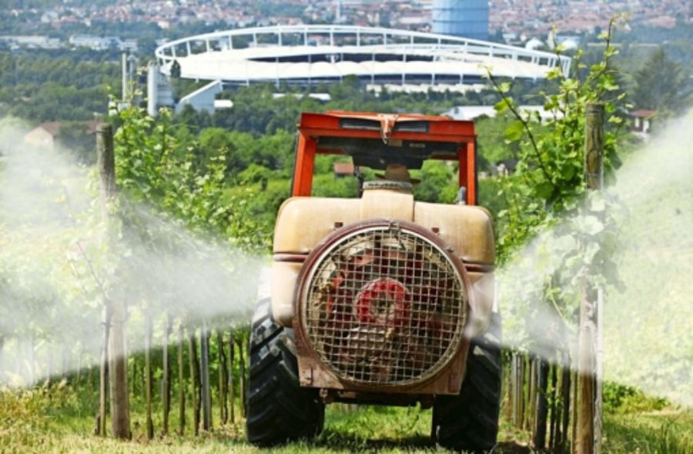
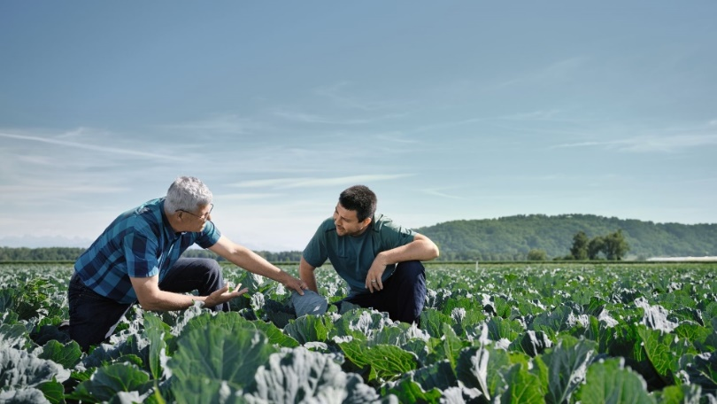
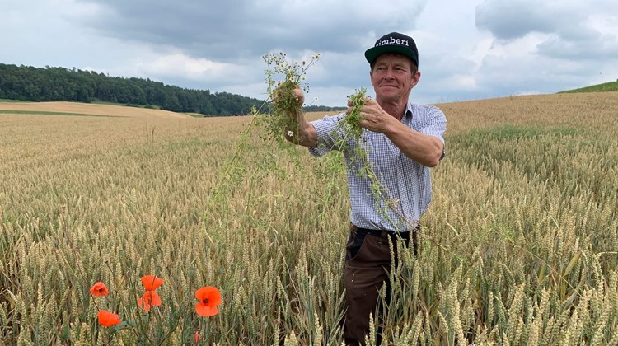
Conclusions
Reduction of pesticide risks requires holistic pesticide policies → pesticide-free production systems are one element
Public policies matter: command and control measures, economic instruments (e.g. subsidies, taxes), provision of extension services, information, education, etc.
Corporate policies need to be adjusted too. Accounting also for up- and downstream actors
Optimal policy packages highly dependent on specific agricultural and food systems
(we hope) Switzerland may serve as role model for innovation in terms of pesticide reduction

Slide 16
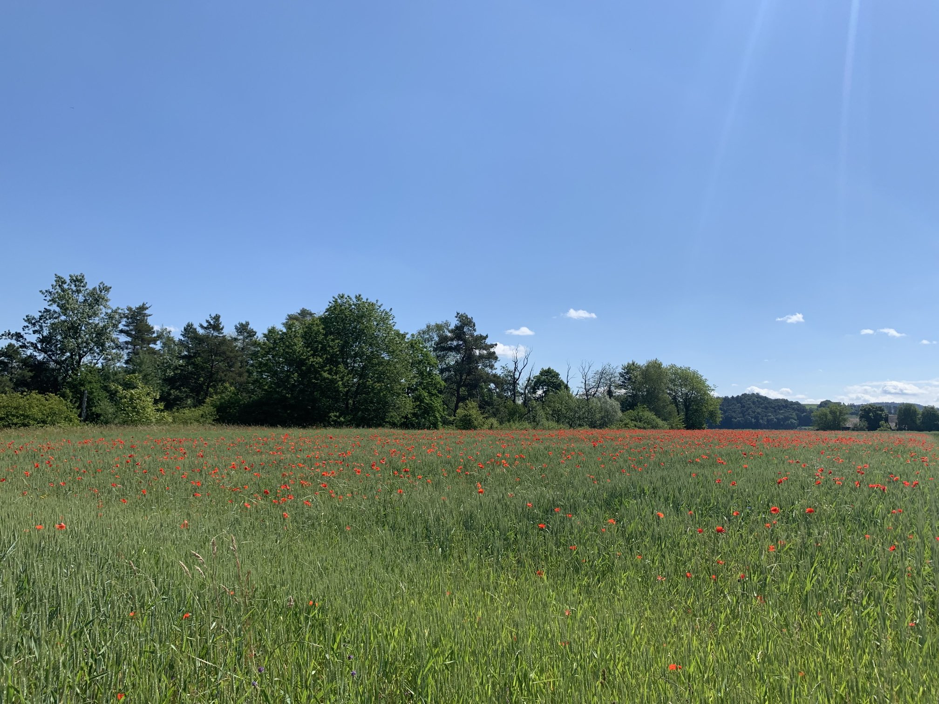
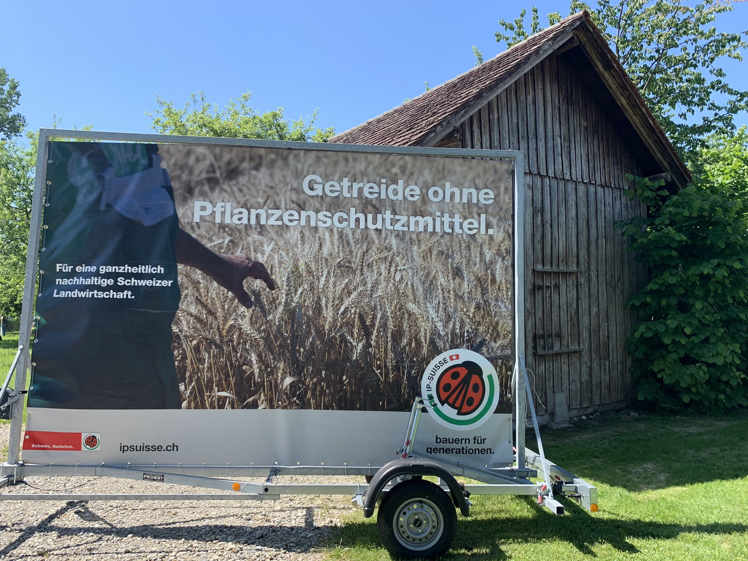
Get in touch!
rofinger@ethz.ch
@RobertFinger1
www.aecp.ethz.ch
https://agrarpolitik-blog.com/

Slide 17
Selected relevant papers with links
Finger, R., Möhring, N. (2022). The adoption of pesticide-free wheat production and farmers’ perceptions of its environmental and health effects . Ecological Economics. 198, 107463 https://doi.org/10.1016/j.ecolecon.2022.107463.
Möhring, N., Finger, R. (2022). Pesticide-free but not organic: adoption of a large-scale wheat production standard in Switzerland . Food Policy 106: 102188 >>
Finger, R. (2021). No pesticide free Switzerland. Nature Plants 7, 1324–1325 >>
Mesnage , R. Straw, E.A., Antoniou, M.N. Benbrook, C. Brown, M.J.F., Chauzat, M-J., Finger, R., Goulson, D., Leadbeater, E., López-Ballesteros, A., Möhring, N., Neumann, P., Stanley, D., Stout, J.C., Thompson, L.J., Topping, C.J., White, B., Zaller, J.G., Zioga, E. (2021). Improving pesticide-use data for the EU. Nature Ecology & Evolution 5: 1560 >>
Knapp, L., Wuepper, D., Finger, R. (2021). Risk Preferences, Personality, and Aspirations: Empirical Evidence from Swiss Fruit growers. Agricultural Economics. In Press >>
Wuepper, D., Roleff, N., & Finger, R. (2021). Does it matter who advises farmers? Pest management choices with public and private extension. Food Policy, 101995. >>
Möhring, N., Ingold, K., Kudsk, P., Martin-Laurent, F., Niggli, U., Siegrist, M., Studer, B., Walter, A., Finger, R. (2020). Pathways for advancing pesticide policies. Nature Food 1, 535–540. https://doi.org/10.1038/s43016-020-00141-4
Schaub, S., Huber, R., Finger, R. (2020). Tracking societal concerns on pesticides – A Google Trends analysis. Environmental Research Letters 15 084049 >>
Möhring, N., Wüpper, D., Musa, T., Finger, R. (2020). Why farmers deviate from recommended pesticide timing: The role of uncertainty and information. Pest Management Science 76(8) 2787-2798 https://doi.org/10.1002/ps.5826
Möhring, N., Bozzola, M., Hirsch, S., Finger, R. (2020). Are pesticides risk decreasing? The relevance of pesticide indicator choice in empirical analysis. Agricultural Economics 51(3) 429-444 >>
Möhring, N., Dalhaus, T., Enjolras, G., & Finger, R. (2020). Crop insurance and pesticide use in European agriculture. Agricultural Systems, 184, 102902 >>
Böcker, T., Britz, W., Möhring, N., Finger, R. (2020). An economic and environmental assessment of a glyphosate ban for the example of maize production. European Review of Agricultural Economics 47(2), 371-402 >>
Finger, R., Möhring, N., Dalhaus, T., Böcker, T. (2017). Revisiting pesticide taxation schemes. Ecological Economics 134: 263–266 >>
Böcker, T., Möhring, N., Finger, R. (2019). Herbicide free agriculture? A bio-economic modelling application to Swiss wheat production. Agricultural Systems 173, 378-392 >>
Finger, R., Swinton, S., El Benni, N., Walter, A. (2019). Precision Farming at the Nexus of Agricultural Production and the Environment. Annual Review of Resource Economics 11: 313-335 >>
Walter, A., Finger, R., Huber, R., Buchmann, N. (2017). Smart farming is key to developing sustainable agriculture. Proceedings of the National Academy of Sciences USA 114 (24) 6148-6150 >>

