Slide 1
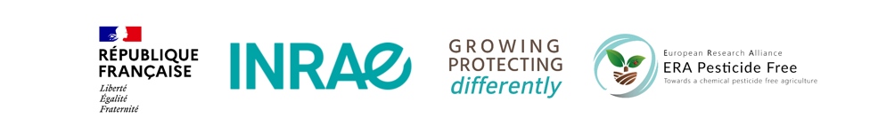


Pesticide-free agriculture as a
new paradigm for research
Florence Jacquet , INRAE
European Scientific Conference – Dijon, June 02 and 03, 2022
Towards Pesticide Free Agriculture

Slide 2
Ten years of European policies towards a reduction of pesticide use in agriculture
EU : Sustainable Use Directive (2009/128/EC)
  «encouraging the development and introduction of integrated pest
  management and of alternative approaches or techniques in order to reduce dependency on the use of pesticides»
  This directive is currently being revised
  Regulations 1107/2009, 1185/2009, 283- 284/2013
2020 European Green Deal & Farm to Fork strategy
  Decrease the use and risk of chemical pesticides by 50% by 2030 and
  Decrease the use of more hazardous pesticides by 50% by 2030
Source Eurostat
Current reduction trajectory is definitively to slow to achieve the Green Deal Objectives

Slide 3
The French National Action Plan: Ecophyto
Launched in 2008
2008: Reduce by 50% the use of pesticide in 10 years if possible
2018: Reduce the use by 50% by 2025.
Actions :
  network of farms and field experiments
  internet information platform
  Research and Innovation support
  pesticides saving certificates
In blue : quantites of pesticide sold excluded biocontrol and organic farming
In green : 3 years average
In red :quantities of products used as biocontrol products and/or in organic farming

Slide 4
Farmer
Historical use of pesticide allowed simplification of cropping systems and loss of natural regulations of pests
Pesticide are cheap, efficient, and easy to use to minimize crop losses risk and maximize yields
Consumer
Budget constraints, dietary habits
Low WTP for pesticide free products
Why is it so difficult to reduce the use of pesticide?
Upstream firms
marketing high-performance equipment, improved seeds, fertilisers and pesticides
Path dependency of Investments
Retailer
Visual quality
Food products preservation
Added-value share
Supply regularity
Pesticide dependency of the agrifood chains
Socio-technical
Lock-in
Downstream firms
organising the collection, processing and marketing of few species
path dependency of investments
Lack of value chains enhancing diversification crops, mixed crops, pesticide free crops..
Extension services
Generic advices focused on helping farmers to minimize risks
Selling companies are the main providers of advices on pesticide use
Research
Research/Innovations are produced for the current cropping systems
Pesticides still perceive as a key element of production systems.
Limits of IPM
Public policies
Ag Policies mainly designed for current systems
Lack of innovative and efficient policies to support ag transition

Slide 5
Research and Innovation in FP7 and H2020
A major effort during the last ten years at the EU level ( FP7, H2020) and at national level:
More than 140 projects are in relation with pesticide use reduction (including projects such as developing legume crops in cropping systems, genetic basis of crop resistance, improving inputs in organic farming) for a total of 384 million euros.
Among them around 100 projects are more directly focused on research for developing alternative solutions to pesticides
EU Total Funding Million euros | In relation with pesticide use reduction | Targeted to pesticide use reduction
FP7 | 117 | 67
H2020 | 267 | 181
TOTAL (2008-2020) | 384 | 248
Excluding projects dealing with health and environmental impacts of pesticides

Slide 6
Research and Innovation in FP7 and H2020
Increase from FP7 to H2020 in all domains but specially in the Digital-Machinery field
Strong effort on biocontrol solutions
Projects are producing breakthrough innovations in several domains by combining fondamental and applied research
However, most of the projects are aimed to find one solution to one pest. Few projects on integration of solutions at the Farm/Landscape/Food chains levels. Very few projects on policies targeted to pesticide use reduction

Slide 7
Towards a paradigm shift : Emerging issues and new fronts of science
Breakthroughs in biological research offer new prospects in crop protection
Microbiota and its impact on plant health
Plant-plant interactions and their impacts on diversification
Chemical ecology, insect and plant odorscapes
Ecological immunology and plant immunity

Slide 8
Pesticide-free agriculture as a paradigm shift for research
Paradigm Shift : "an important change that happens when the usual way of thinking about or doing something is replaced by a new and different way." “When paradigms change, the world itself changes with them” Thomas Kuhn, The Structure of Scientific Revolutions (1962)
Paradigm shift : thinking crop protection without pesticides. To achieve a strong reduction in pesticide use, we must aim for a pesticide-free agriculture to explore new scientific horizons.

Slide 9
Pesticide-free agriculture as a paradigm shift for research
Setting a pesticide-free goal for research forces to :
  Move to systemic changes
  Put prophylaxis as the main objective
  Go further in the search for disruptive solutions and breakthrough innovations
  Consider the need to combine the advances in the different disciplines in an integrated way
  Mobilise the social sciences to understand how to unlock the system
This leads to major changes in research priorities and methods in agronomy, genetics and breeding, biocontrol,machinery and digital, social and economic sciences.
Some challenges are cross cutting the different domains : we identify 4 main challenges

Slide 10
→ 4 key challenges and their implications for research
Prioritize natural regulations
Work at landscape scale
Analyze the required transition of the value chains
Focus on tailored solutions instead of generic solutions
Jacquet, F., Jeuffroy, M. H., Jouan, J., Le Cadre, E., Litrico, I., Malausa, T., Reboud X., Huyghe, C. (2022). Pesticide-free agriculture as a new paradigm for research. Agronomy for Sustainable Development,

Slide 11
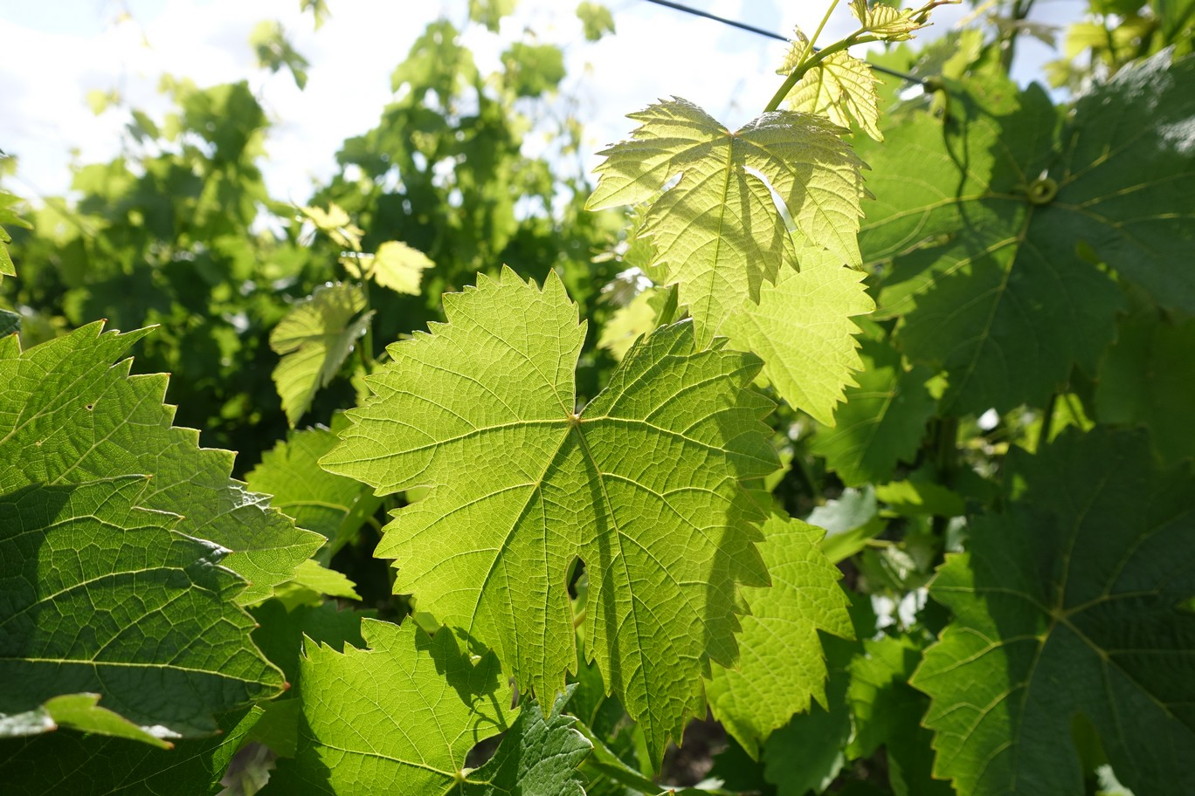
1. Pesticide Free cropping systems based on natural regulations
Focus on interactions of biocontrol with other agroecological practices rather than with pesticides
Understand and manage the interactions among genotype, microbiome, soil and agronomic practices
Increase diversification: rotation, intercropping, mixed cropping
Develop new breeding strategies to increase resistance and optimize efficiency and durability of resistance
Enlarge the scope of breeding programs to include functional biodiversity and evolutionary ecology concepts
Introducing flowerbeds at the edge of the field makes it possible to reproduce semi-natural habitats that are rich in plant biodiversity
and offer habitat and trophic resources to the auxiliaries. (INRAE-Platform CA-SYS)
The use of grape varieties resistant to leaf diseases (oidium, mildew) opens up new perspectives for viticulture. Combined with suitable practices, these grape varieties can reduce the use of fungicides against aerial diseases by up to 90%.
(INRAE- OSCAR, a national observatory to support the deployment of new grapevine disease resistant varieties in France)
Species and varietes adapted to mixtures or intercropping: ability to coexist and to optimize the adaptation and interaction capacities
of plants with their biotic environment . Photo by E Le Cadre (REMIX)

Slide 12
2. Think natural regulations at the landscape scale
Design the spatial organization of crops and cultivars
Manage the pest populations on the mid/long‑term
Develop digital tools and information networks for epidemiological surveillance and monitoring of prophylaxis
Understand and manage the combined effects of agronomic practices, biocontrol, and natural habitats
EPIDEMIOLOGICAL SURVEILLANCE
Challenges, methods, and tools that need to be bridged via multidisciplinary approaches for enhancing epidemiological surveillance and prevention of plant diseases
Morris, C. E et al. (2022).. Plant Pathology, 71(1), 86-97. and BEYOND project
MOSAICS : Pesticide-free agriculture cannot be conceived without managing the spatial heterogeneity of landscapes: the design of mosaics of cropping systems, in interaction with semi-natural habitats, is essential to promote the ecological processes that lead to natural regulation of pests.
ODORSCAPES :
The. communication network between plants,
Volatil plant Volatile Plant Compounds and insect spaces
Conchou, L., et al. (2019).. Frontiers in physiology, 972

Slide 13
3. Tailored solutions instead of generic solutions
Bridge farmers’ experience and scientific knowledge
Design equipment and machinery adapted and adaptable to a range of pesticide-free systems
Implement participatory breeding to obtain varieties and mixtures defined by site-specific conditions or practices
The in-depth transformation of agricultural practices, necessary for the success of zero-pesticide systems, is enriched by (1) collective design processes that rely on exchanges between practitioners and researchers and promote the exploration of innovative solutions, and by (2) the confrontation of the solutions imagined to real situations
of implementation (agricultural plots).. Photograph by
Laurette Paravano

Slide 14
4. value chains and public policies
The use of Trichogramma micro-wasps against lepidopteran pests has been an undeniable biocontrol success story for several decades. It illustrate the need for development of new business models, which deviate from the current strategies conceived for massively used pesticides. Photo JP Malausa
Strategies of upstream companies (equipement, breeding, biocontrol sector)
Strategies of downstream companies (diversification, mixed crops, pesticide-free products)
Design innovative public policies
Diversification requires a range of technical and organisational innovations
to help remove barriers all along the value chain from farmers to consumers,
PHOTOS : Project DiverIMPACTS (H2020)
Impact of a pesticide tax on optimal pesticide use and welfare (r=2)
Bontemps, C., Bougherara, D., & Nauges, C. (2021). Do risk preferences really matter? The case of pesticide use in agriculture. Environmental Modeling & Assessment, 26(4), 609-630.

Slide 15
Conclusions : New perspectives are underway
European Research Alliance ‘Towards a chemical pesticide-free agriculture’
French National Research « Cultiver et Protéger Autrement » (Growing and Protecting Crops Differently)
  30 million euros
  10 projects: integrated multidisciplinary , public policies, epidemiosurveillance, microbiote
It offers perspectives for impacts such as :
  A variety of crop mixtures adapted to local context
  Innovative co-design approaches to build pesticide-free agrosystems at territory level
  New epidemiological surveillance strategies to implement prophylaxis
  Novel solutions for seed protection
  Combinations of genetic resistance, biocontrol and management options adapted to different cropping systems
  New solutions based on plant-microbiota interactions
  Political and organizational solutions to trigger the transition
The change in paradigm concerns not only the topics addressed by researchers but also the way research is done, the way to implement interactions with farmers, agroindustries, policy-makers.

Slide 16
Thank you for your attention !

